Slide 1


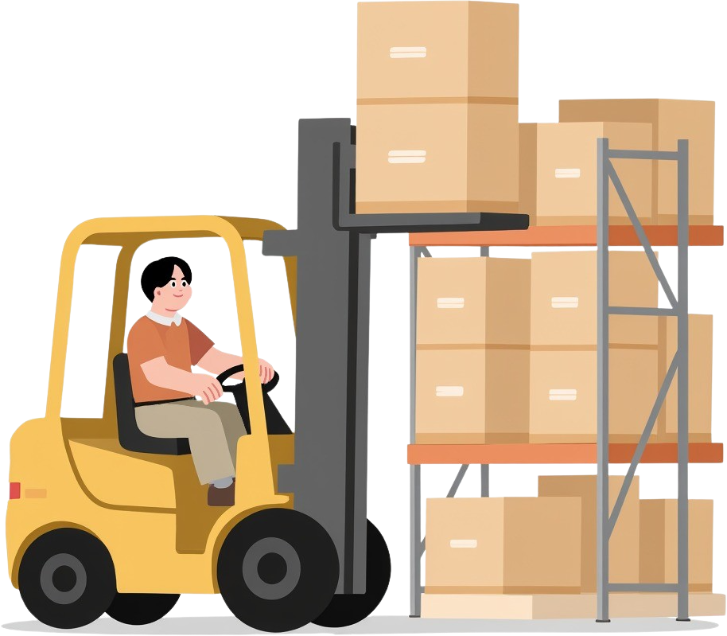

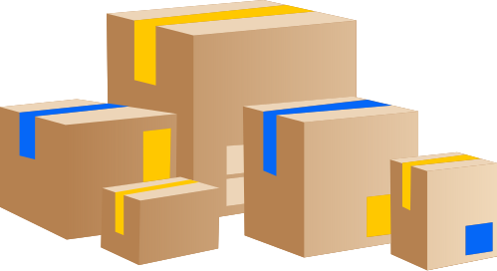


WAREHOUSE SLOTTING OPTIMIZER
Battapothula Guru Sai- 2520090075
Sampati Varun Sridhar Reddy 2520090083

Slide 2

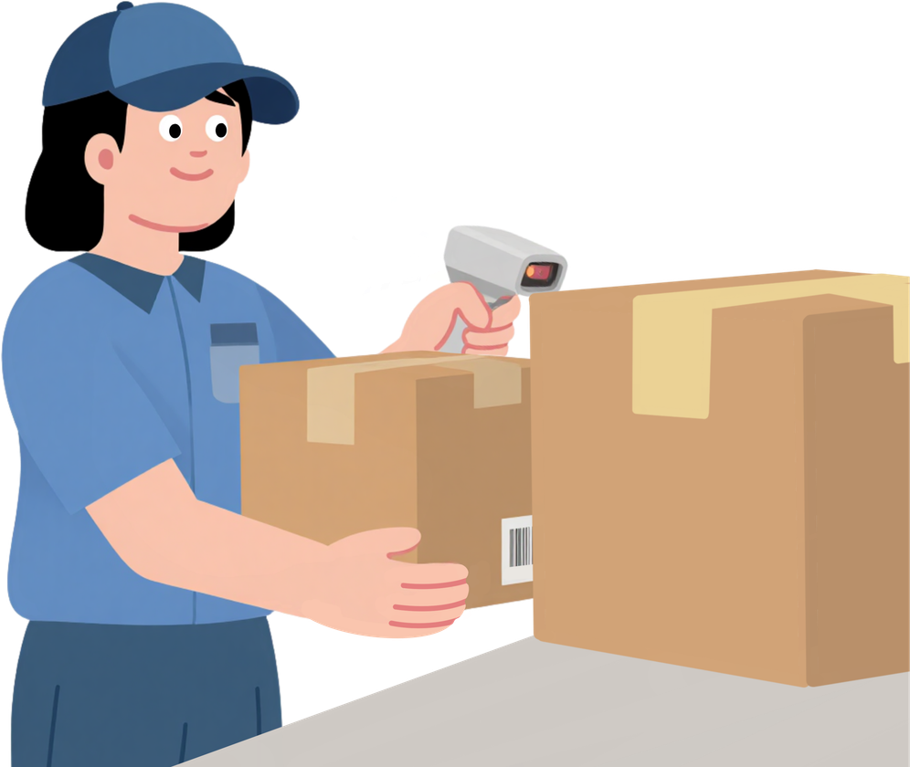
Home
Gallery
About Us
Menu
Abstract
The Warehouse Slotting Optimizer is a system that helps organize products in a warehouse to make order picking faster and more efficient. In many warehouses, workers spend a lot of time walking to collect items for customer orders. This project analyses past order history to find products that are often picked together. These related products are then placed in nearby storage locations to reduce travel distance. The system first cleans the product and order data, then identifies common co-pick patterns using data mining techniques. Based on these patterns, it recommends the best storage slots for each product. By placing frequently ordered items closer together, the system improves picking speed, saves time, and reduces worker effort. This project is useful for warehouses, supermarkets, and e-commerce companies that want to improve their storage layout, increase productivity, reduce operational costs, and provide faster order delivery to customers.
01

Slide 3
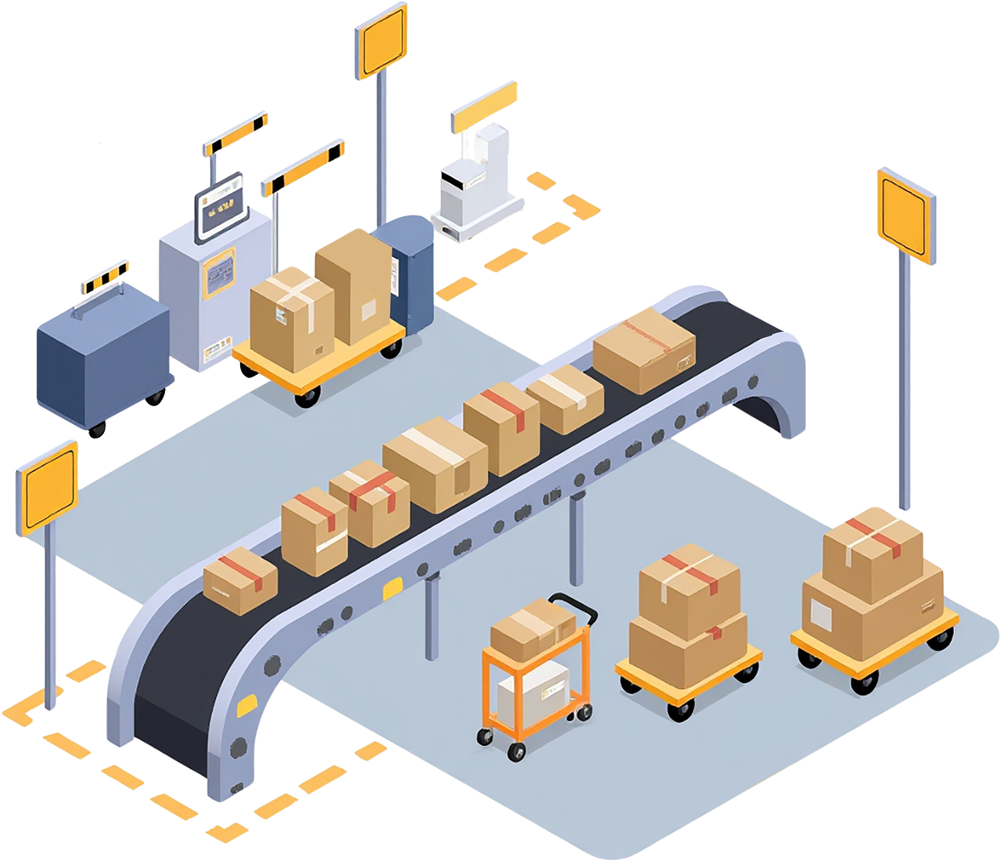
Introduction
Warehouse slotting is the process of deciding where products should be placed inside a warehouse. Proper product placement helps workers find and collect products faster.
In a warehouse, high-demand products are picked more frequently. If these products are stored far from the dispatch area, workers have to travel longer distances, which increases picking time and operational effort.
Our project, Warehouse Slotting Optimizer, uses Java and Data Structures & Algorithms (DSA) to improve product placement. The system analyzes product demand and assigns frequently picked products to more accessible slots.
The project uses concepts such as ArrayList, HashMap, PriorityQueue, sorting, searching, and greedy algorithms to organize products and warehouse slots efficiently.
Main Goal
To reduce product picking time and travel distance by placing high-demand products in better warehouse locations.
02

Slide 4

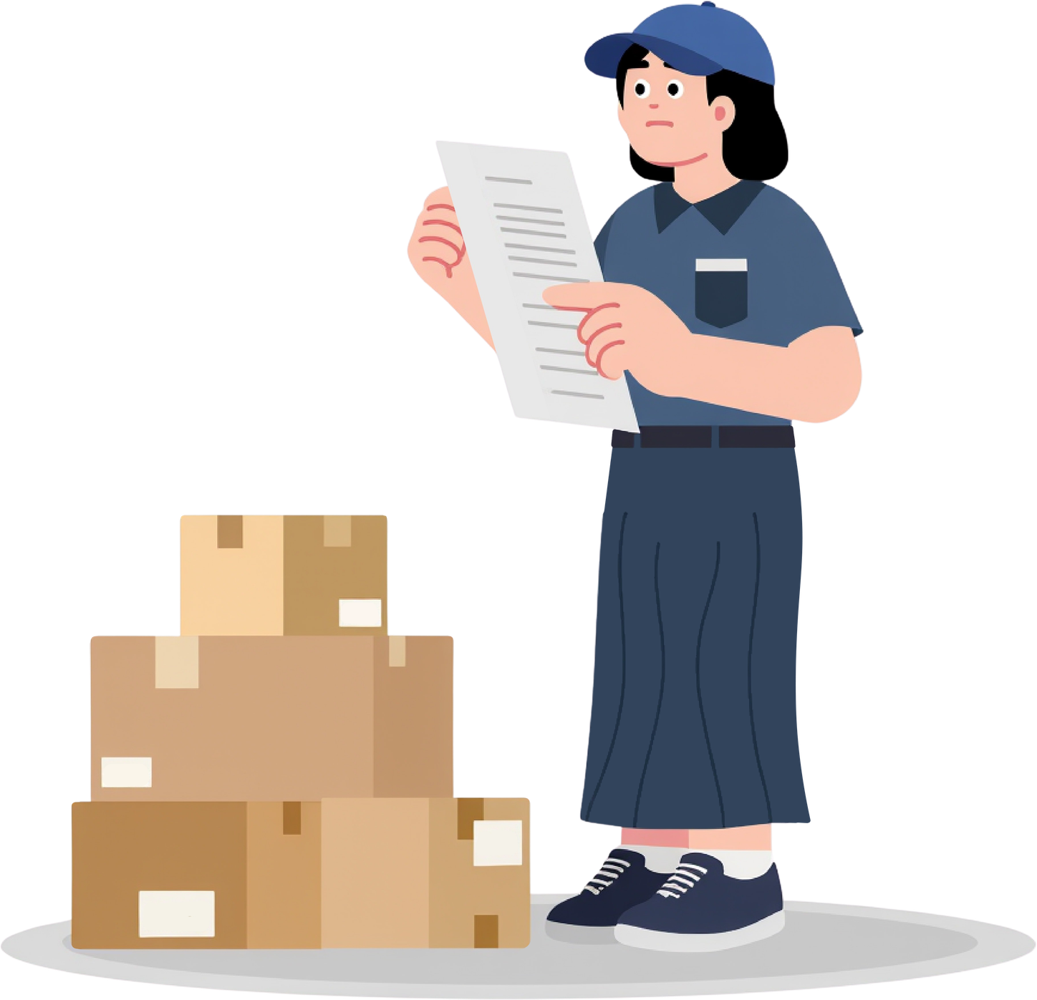
Literature Survey
Study 1 — Order Picking and Storage Assignment
Research by de Koster, Le-Duc and Roodbergen reviewed warehouse order-picking systems and identified storage assignment, routing, zoning, batching, and layout as important optimization areas.
Relevance to our project:
Our system focuses specifically on storage assignment/slotting to reduce picking effort.
Study 2 — Class-Based Storage
Chan and Chan studied class-based storage and found that appropriate storage assignment can improve order retrieval time and travel distance. Their work considered factors such as demand trends, turnover rate, product characteristics and warehouse layout.
Relevance:
Our project uses product demand/frequency to prioritize storage locations.
03

Slide 5

Software and HardWare Requirements
Software Requirements
Programming Language: Java
JDK: JDK 17 or above
IDE: VS Code / IntelliJ IDEA / Eclipse
Operating System: Windows 10/11 or Linux
Data Structures: ArrayList, HashMap, PriorityQueue
Algorithms: Sorting, Searching, Greedy Algorithm
Database: Not required for the basic version
Hardware Requirements
Processor: Intel Core i3 or equivalent
RAM: Minimum 4 GB
Storage: Minimum 500 MB free space
Display: 1366 × 768 resolution or higher
Input: Keyboard and Mouse
Internet: Not required for running the basic Java application
04

Slide 6
Methodology
The Warehouse Slotting Optimizer uses a simple process to assign products
to the most suitable warehouse slots.
1. Collect Data
  Product ID
  Demand/Frequency
2. Store Data
  ArrayList → Product & slot details
  HashMap → Fast product lookup
  PriorityQueue → Product priority
3. Calculate Priority
Products are ranked based on demand and picking frequency.
4. Sort Products
Products are arranged from highest to lowest demand.
5. Assign Slots
High-priority products are assigned to easily accessible
6. Calculate Distance
Estimate picker travel distance and retrieval time.
7. Optimize Layout
Generate the final optimized warehouse slot arrangement.
Collect Data
↓
Store Data
ArrayList + HashMap
↓
Calculate Priority
↓
Sort Products
Sorting Algorithm
↓
Assign Slots
PriorityQueue + Greedy
↓
Calculate Distance
↓
Optimized Layout
05

Slide 7


Borcelle Company
Home
Gallery
About Us
Menu
Thank You
17

